Slide 1
Triangulation Using Computer Vision
Cot5930: Introduction to Robotics
Dr. Ravi Shankar
By
Huajin Ariel Qu & Charles Perry Weinthal

Slide 2
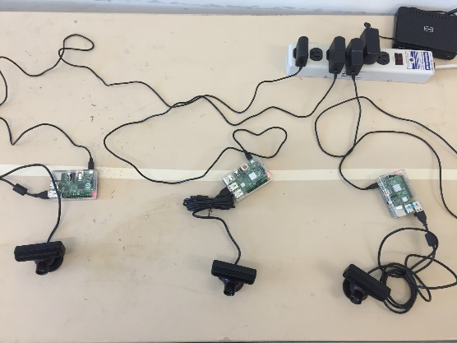
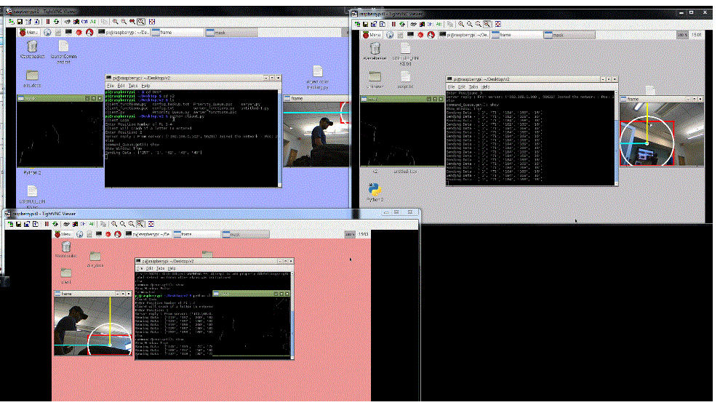
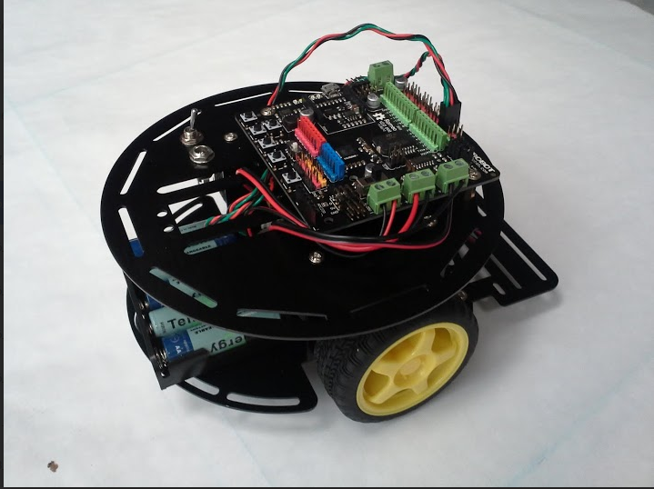
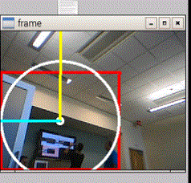
Overview
Four Raspberry Pi have been configured with USB WebCams to view the movement grid, these four units then report via WiFi connections to a main computational and control Unit. The main unit will then compute the distance using triangulation and command the Robot to move via a Bluetooth interface.

Slide 3



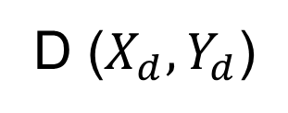

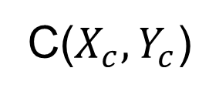
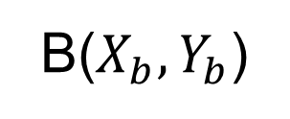
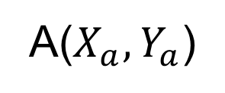
Where is the Robot?
C($X_{c},Y_{c}$)
B($X_{b},Y_{b}$)
$$α3$$
$$α2$$
b
c
(x,y)
d
Cameras are
located at
A, B, C, D
a
$$α4$$
$$α1$$
A($X_{a},Y_{a}$)
D ($X_{d},Y_{d}$)

Slide 4

Triangulation Formulas
$$x={±X}_{camera}±D∗ F\left(α\right)$$
$$y={±Y}_{camera}±D∗G\left(α\right)$$
$$D=\left(a,b,c,d\right)$$
For Camera A & C: $F\left(α\right)=sinα : G(α)= cosα$
For Camera B & D: $F\left(α\right)=cosα : G(α)=sinα$
$x=$ $X_{a}+a sinα_{1} : y= Y_{a}+a cosα_{1}$
$x=$ $X_{b}+b cosα_{2} : y= Y_{b}−b sinα_{2}$
$x=$ $X_{c}−c sinα_{3} : y= Y_{c}−c cosα_{3}$
$x=$ $X_{d}−d cosα_{4} : y={ Y}_{d}\text{ + }\text{d} sinα_{4}$

Slide 5
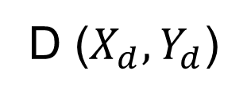
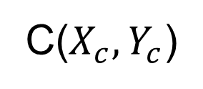
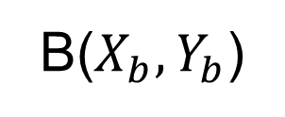
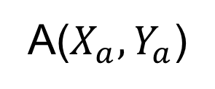

Current Camera View
B($X_{b},Y_{b}$)
C($X_{c},Y_{c}$)
Cameras are
located at
A, B, C, D
Inside the arc is the linear zone.
The angles are the vision boundaries.
$$l$$
A($X_{a},Y_{a}$)
D ($X_{d},Y_{d}$)

Slide 6

Choose the best camera for your solution
Not all cameras will have solutions that satisfy:
$$0≤\left(a,b,c,d\right)≤{\text{Distance}}_{l_r}$$
${\text{Distance}}_{l_r}$ = camera’s linear range
$$min≤\left(α_{1},α_{2},α_{3},α_{4}\right)≤max$$

Slide 7

Errors & Confidence in the Data
By empirical analysis the accuracy is:
Derror =$\frac{1}{D^{1.1}}$
Θcenter = $\frac{\text{1⁰}}{5 \text{pixels}}$

Slide 8

Optimizing For the Best Results.
Not all cameras will have solutions that satisfy:
< 1% error if D $≤180"$
$x=X_{camera}±D∗ F\left(α\right)±$ $∆{Error }_{x}$
$y=Y_{camera}±D∗G\left(α\right)±$ $∆{Error }_{y}$
$$D=\left(a,b,c,d\right)$$
$∆{Error }_{x}= \frac{1}{D^{1.1}}$ $∆{Error }_{y}=\frac{1}{D^{1.1}}$
For Camera A & C: $F\left(α\right)=sinα : G(α)= cosα$
For Camera B & D: $F\left(α\right)=cosα : G(α)=sinα$
$$15⁰≤\left(α_{1},α_{2},α_{3},α_{4}\right)≤75⁰$$
Angle errors to be examined in detail later, per Dr. Shankar 15apr2015

Slide 9
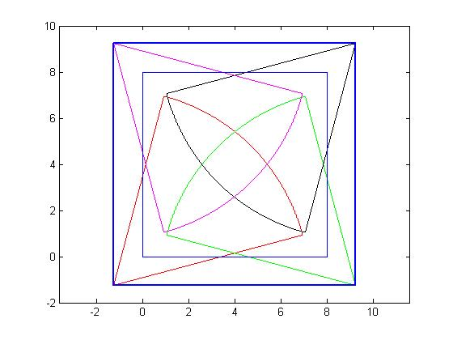
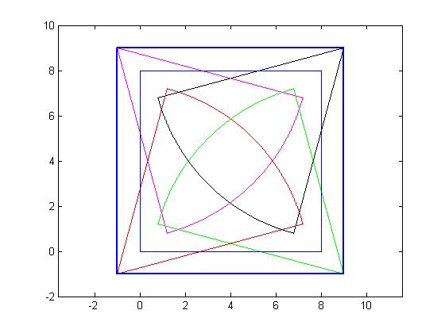
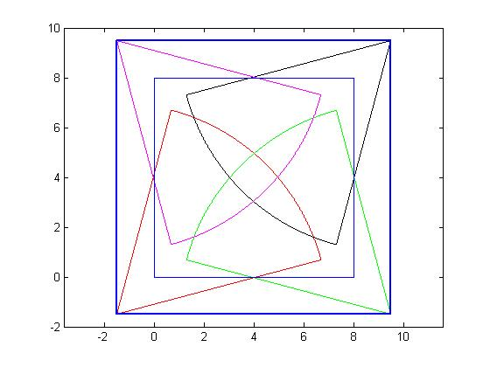
At an offset of (1.25,1.25) the coverage is 99.43% of the field
Optimal Camera Placement When the cameras are placed at an offset of (1.5,1.5) the four cameras can cover 100% of the field. (see the MatLab file: camera_cover.m)
At an offset of (1,1) the coverage is 97.31% of the field

Slide 10
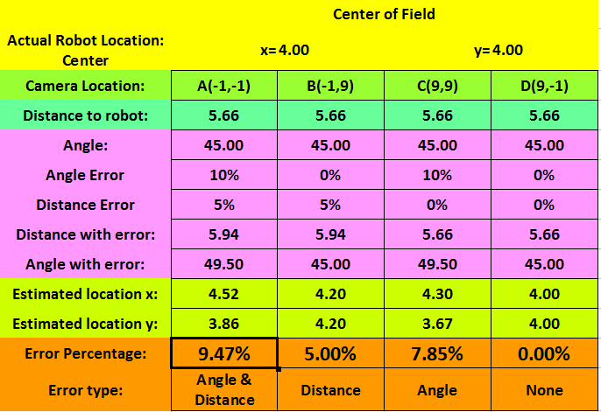
Error Analysis
At the center (4,4):

Slide 11
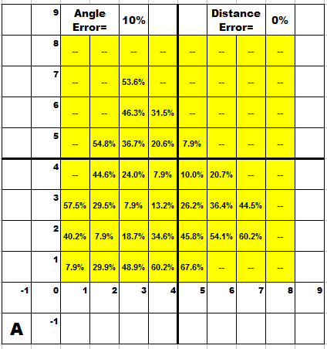
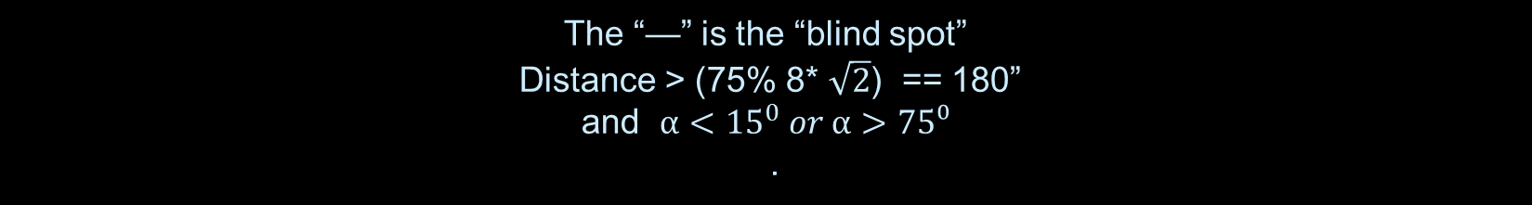
The “—” is the “blind spot” Distance > (75% 8* $\sqrt{2}$) == 180” and ${α<15}^{0} or α>75⁰$ .
Error Analysis, cont’d
As viewed from Camera A at (1.5,1.5)

Slide 12
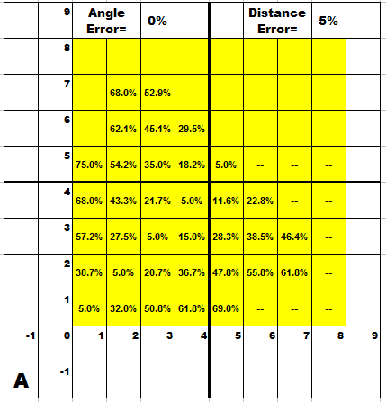
The “—” is the “blind spot” Distance > (75% 8* $\sqrt{2}$) == 180” and ${α<15}^{0} or α>75⁰$ .
Error Analysis, cont’d
As viewed from Camera A at (1.5,1.5)

Slide 13
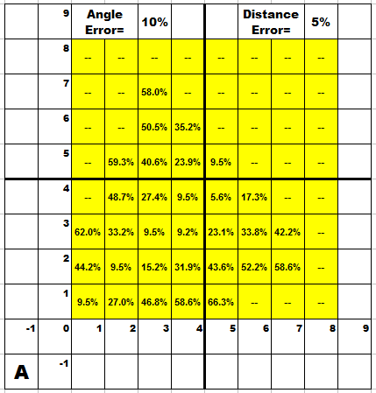
The “—” is the “blind spot” Distance > (75% 8* $\sqrt{2}$) == 180” and ${α<15}^{0} or α>75⁰$ .
Error Analysis, cont’d
As viewed from Camera A at (1.5,1.5)

Slide 14
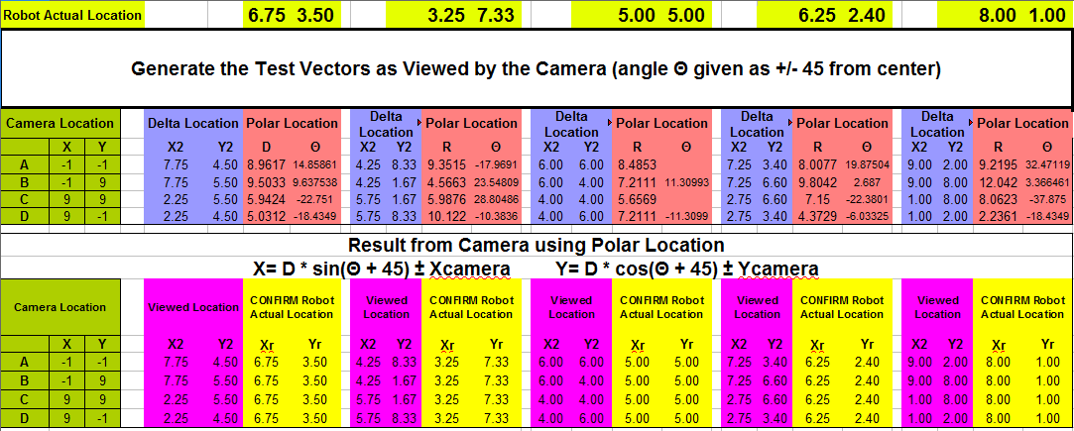
Locations, Distances & Vectors
We generated a few test vectors (pink) to verify the triangulation code.

Slide 15
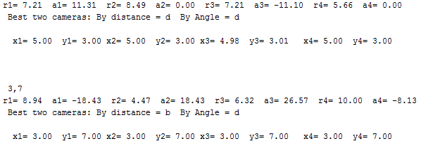
Python Code
The code expects 4 vectors and yields the Cartesian coordinates:

Slide 16
Areas for Further Investigation:
* Other camera positions and count maybe possible.
Image edge detection and object position are an area to be carefully investigated. Area of concerns include the object contrast and edge “quality” will have a significant affect on the accuracy.
Robot movement and control need to further refined and optimized.

Slide 17
Credits & Acknowledgments
Photo Credits:
Santiago Aguerre
Caio Farias
Charles Weinthal
Huajin Qu

